Slide 1
amazon
Data Visualization Dashboard

Slide 2

PROBLEM STATEMENT
Data Visualization Dashboard: Create interactive data visualization dashboards using tools like Tableau or Power BI to provide stakeholders with insights and trends.
Do ETL : Extract-Transform-Load some Amazon dataset and find for me Sales-trend -> month wise , year wise , yearly month wise.
Find key metrics and factors and show the meaningful relationships between attributes.

Slide 3
Benefits
Help out to make the better business decisions.
Help analyze customer trends and satisfaction, which can lead to new and better products and services.
Gives better insights of customers base.
Helps in easily flow for managing resources.

Slide 4


Architecture
Data Pre- Processing
Raw Data Collection
Importing Libraries in Jupyter Notebook
Load Dataset
Missing Value
Imputations
Handling
Outliers
Data Cleaning
Deployment
Insights
Power BI
Desktop
Modelling
Exploratory
Data Analysis
(EDA)
Reporting
✔ Low-Level Design Document
✔ High-Level Design Document, Architecture Document
t

Slide 5
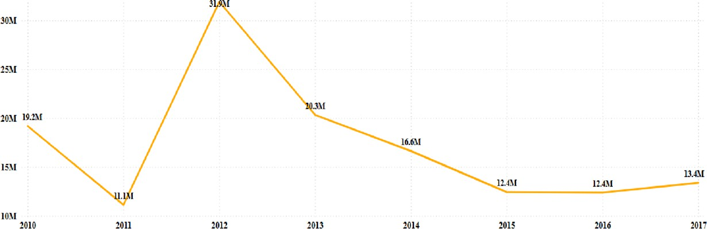
Timeline
As observed from the given dataset from year 2010 to 2017, in the fiscal year of 2012 the Revenue gained is $31.90 Million and the Profit earned is $9.21 Million.
On moving further on the timeline, there is a 36.27% decrease in the Revenue and Profit Margins in 2013 which keeps on decreasing till 2016.

Slide 6
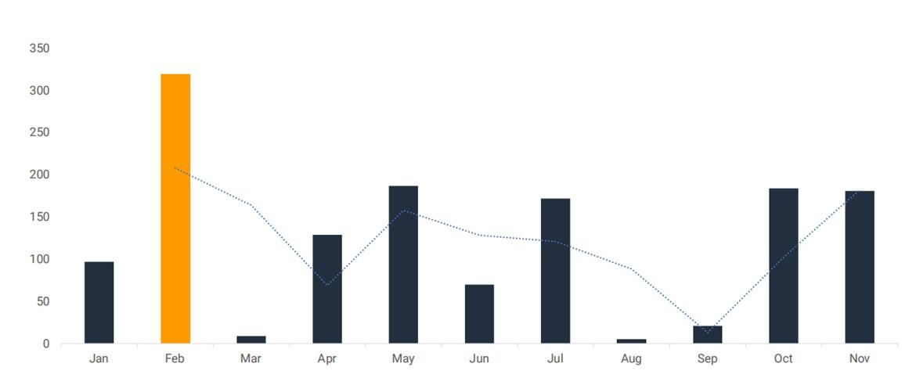
Monthly Growth Chart
The sales in February has the highest sales of 319M

Slide 7
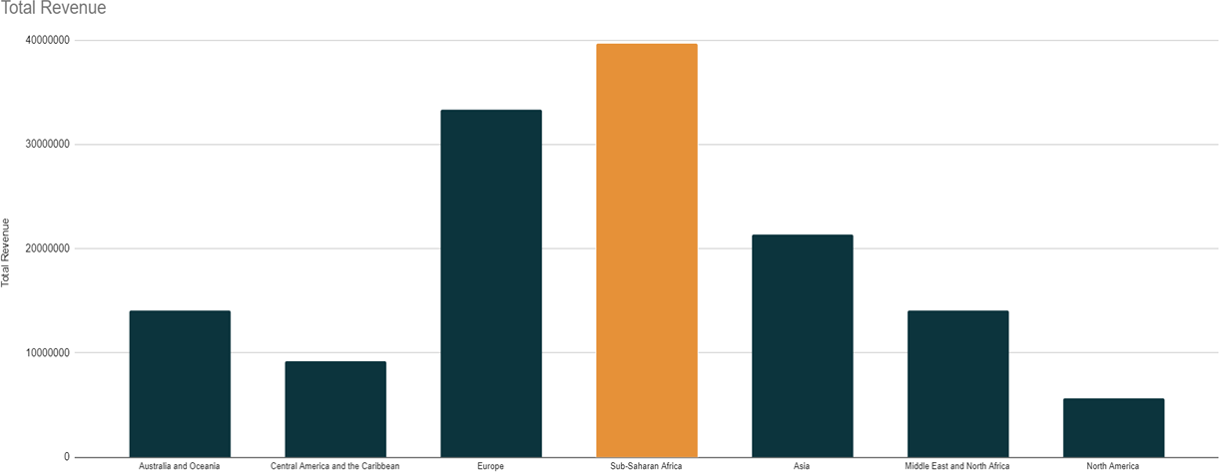
Total Revenue
Sub-Saharan Africa has the highest revenue

Slide 8
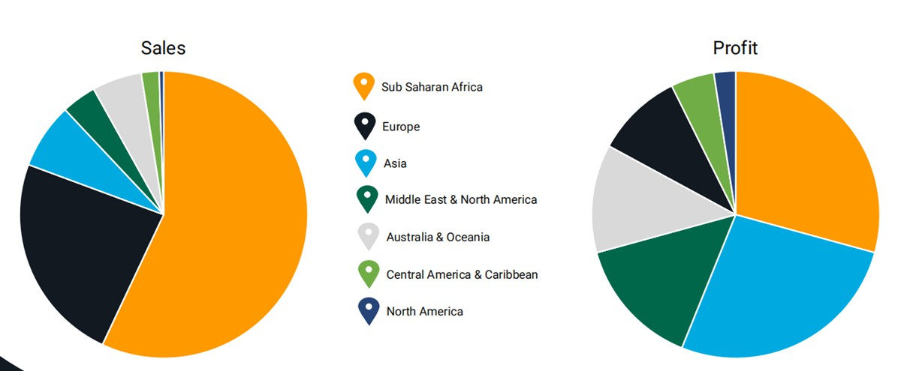
Sales & Profit by the region
Sub Saharan has the highest profit and sales

Slide 9
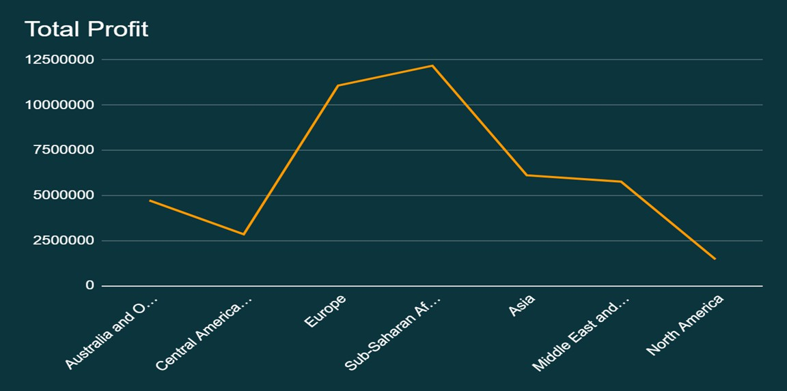
Total Profit

Slide 10
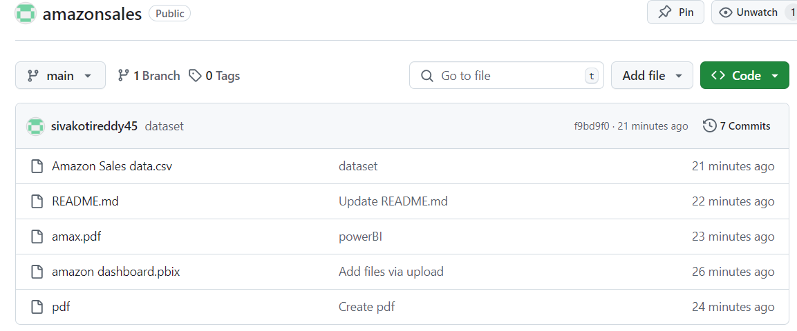
Resources
GitHub Link:
https://github.com/sivakotireddy45/amazonsales

Slide 11
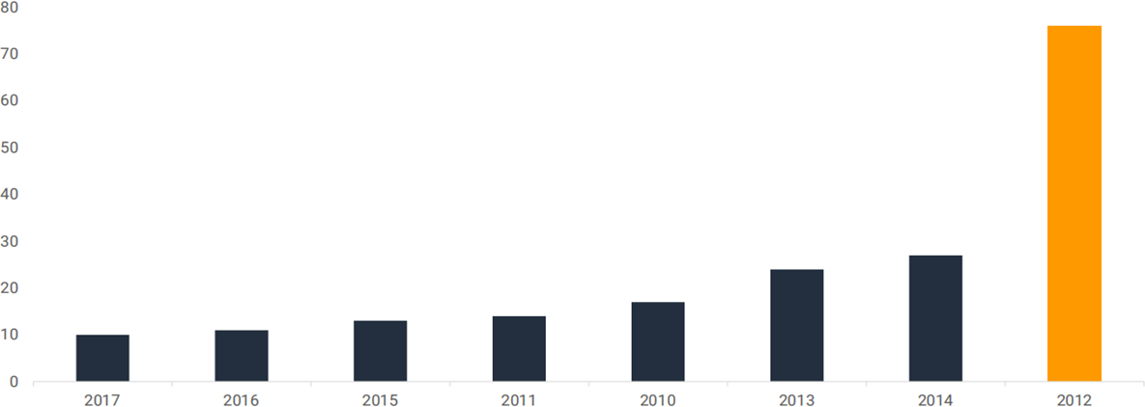
Yearly Growth Chart
2012 has the highest revenue at 76M+ sales

Slide 12
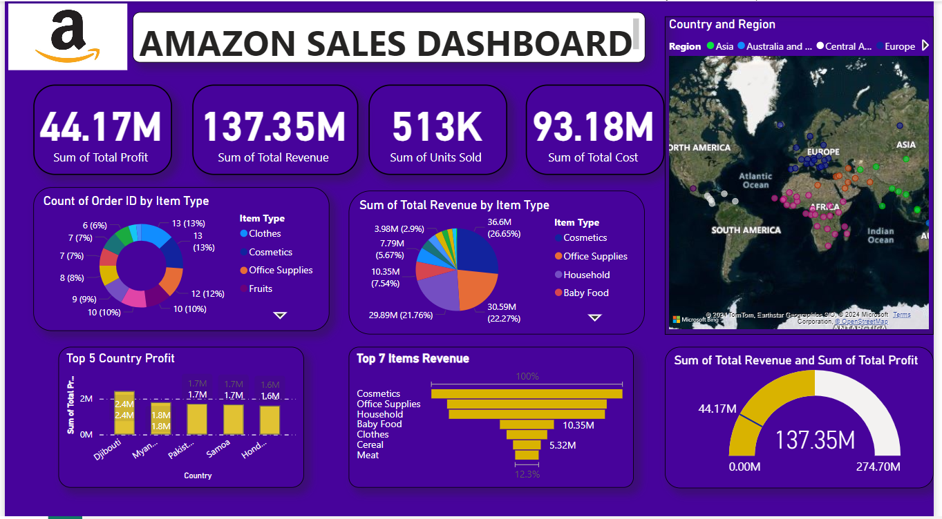
DashBoard

Slide 13
Thanks!
Siva KotiReddy

